Slide 1
DICER: Diligent Cache Partitioning for Efficient Workload Consolidation
Konstantinos Nikas, Nikela Papadopoulou, Dimitra Giantsidi,
Vasileios Karakostas, Georgios Goumas, Nectarios Koziris
Computing Systems Laboratory
National Technical University of Athens

Slide 2
INTRODUCTION
Overview
Problem: Performance degradation due to co-location
  Slowdown + Unpredictability
Reason: Contention for shared resources
  Cache space, memory bandwidth
State of practice: Keep resources underutilized
  Cores remain idle to avoid interference & meet QoS
Our solution: A mechanism that co-locates a high-priority with many best-effort workloads and assigns resources adaptively
  Leverage Cache Monitoring, Memory Bandwidth Monitoring & Cache Allocation facilities
Result: Improved conformance to SLOs and System Utilization

Slide 3
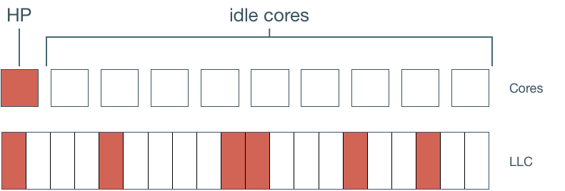
INTRODUCTION
Motivation
Multi-core systems dominate
in HPC and cloud datacenters
Workloads have different quality-of-service
requirements (Service Level Objectives)
Co-location often degrades performance
& affects Quality of Service (QoS)
Co-location is avoided to safeguard QoS
  Cores remain idle to avoid interference, resources underutilized
  Low effective system utilization

Slide 4
INTRODUCTION
Our proposal
DICER: a dynamic cache-partitioning scheme to solve the problem of co-locating high-priority (HP) and best-effort (BE) applications
 | Dynamic cache partitioning [Cook et al. ISCA’13] | Heracles [Lo et al. ISCA’15] | Ubik [Kasture et al. ASPLOS’14] | Dirigent [Zhu et al. ASPLOS’16] | DCP-QoS [Papadakis et al. COSH’16] | DICER
Aware of memory bandwidth saturation | ✘ | ✓ | ✓ | ✓ | ✘ | ✓
Agnostic to target performance | ✓ | ✘ | ✘ | ✘ | ✓ | ✓
No hardware extensions required | ✓ | ✓ | ✘ | ✓ | ✓ | ✓
No application profile required | ✓ | ✓ | ✓ | ✘ | ✓ | ✓

Slide 5
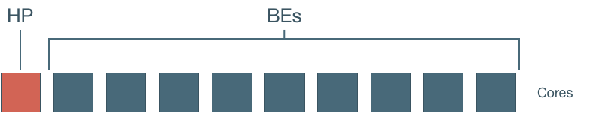
BACKGROUND
Execution scenario and setup
One high-priority application (HP) executes on one core of the server
Multiple instances of another
best-effort application (BE) execute on the remaining cores of the server
Processor | Intel Xeon E5-2630 v4 (Broadwell) 10 cores, 2.2GHz, SMT disabled
LLC | 25MB, 20-way set associative
Memory Bandwidth | 68.3 Gbps per channel
Memory | 128GB DDR4
3481 multi-programmed workloads
Parsec 3.0
SPEC CPU 2006

Slide 6
BACKGROUND
Intel RDT
Thread(s)
Thread(s)
Thread(s)
Thread(s)
Thread(s)
Thread(s)
Thread(s)
Thread(s)
Thread(s)
Application(s)
Thread(s)
VM(s)
Cache Monitoring Technology (CMT)
  Monitors LLC utilization by cores and/or applications
Memory Bandwidth Monitoring (MBM)
  Monitors memory bandwidth utilization by cores and/or applications
Cache Allocation Technology (CAT)
  Controls data allocation of cores and/or applications into the last-level cache
    Provides isolation and prioritization
Flexible N:M mapping
Classes of Service (CLOS) - logical
HW enforces guidelines per CLOS - physical
Intel CAT
One or more PIDs or cores are mapped to a CLOS
Way-based segmentation using bitmasks
Each bit of the mask corresponds to 1 way of every set
We apply a mask per CLOS

Slide 7
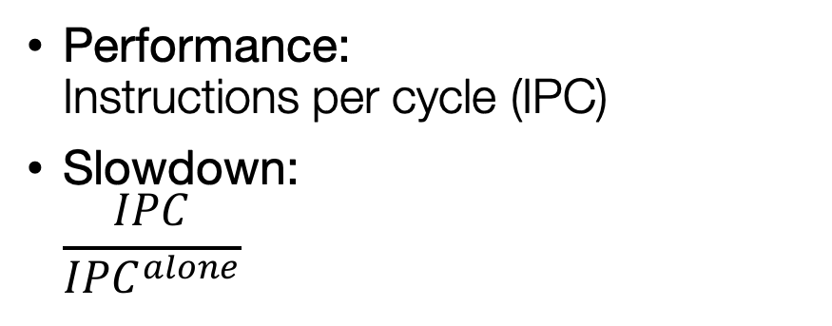
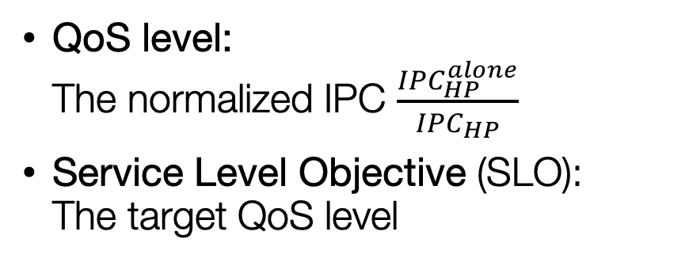
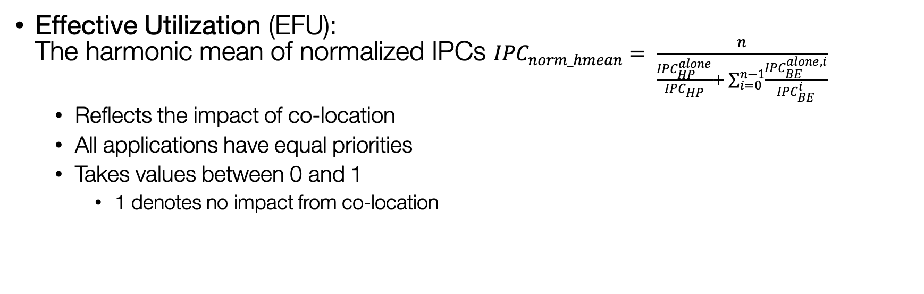
BACKGROUND
Metrics
Performance:
Instructions per cycle (IPC)
Slowdown:
$\frac{IPC}{{IPC}^{alone}}$
QoS level:
The normalized IPC $\frac{{IPC}_{HP}^{alone}}{{IPC}_{HP}}$
Service Level Objective (SLO):
The target QoS level
Effective Utilization (EFU):
The harmonic mean of normalized IPCs ${IPC}_{norm_hmean}= \frac{n}{\frac{{IPC}_{HP}^{alone}}{{IPC}_{HP}}+ \sum_{i=0 }^{n−1}{\frac{{IPC}_{BE}^{alone, i}}{{IPC}_{BE}^{i}}}}$
  Reflects the impact of co-location
  All applications have equal priorities
  Takes values between 0 and 1
    1 denotes no impact from co-location

Slide 8
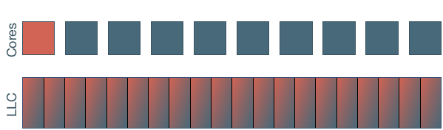
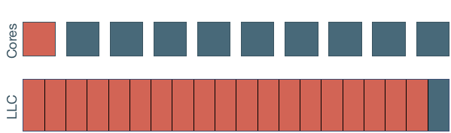
ANALYSIS
Baseline co-location policies
Unmanaged (UM)
No control on resource sharing
Contention-unaware policy
Cache-Takeover (CT)
Maximum possible LLC portion allocated to the HP
Conservative policy

Slide 9
ANALYSIS
Impact of co-location on HP performance
Slowdown of HP < 1.1x
UM: 65% of workloads
CT: 95% of workloads
No slowdown of HP
UM: 5% of workloads
CT: 15% of workloads

Slide 10
ANALYSIS
LLC allocation and performance (in isolation)
10% loss in performance with only 5 LLC ways
for 90% of applications
1% loss in performance
with only 6 LLC ways
for 50% of applications

Slide 11
ANALYSIS
Key observations
  Cache-Takeover leads to suboptimal use of resources
  Performance can be maintained with fewer LLC ways
  Application cache requirements change throughout execution
Observation 1

Slide 12
ANALYSIS
Co-location and bandwidth saturation
Up to 1.7x slowdown as more ways are given to HP
No slowdown for up to 6 ways
1.45x slowdown with CT
No slowdown with UM!

Slide 13
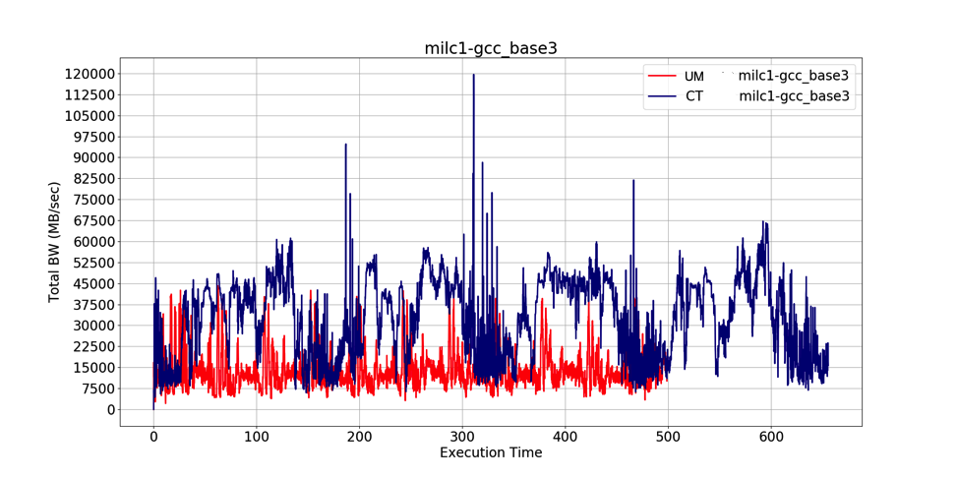
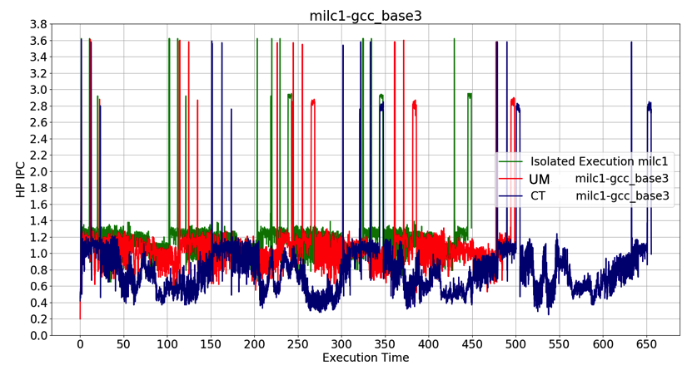
ANALYSIS
Co-location and bandwidth saturation
Extreme increase of total bandwidth as we constrain BEs to 1 cache way
Execution time slowdown with CT
milc (HP)
UM: LLC utilization 26%
CT: LLC utilization 97%
HP IPC with UM follows that of isolated execution

Slide 14
ANALYSIS
Key observations
  Cache-Takeover leads to suboptimal use of resources
  Performance can be maintained with fewer LLC ways
  Application cache requirements change throughout execution
Observation 1
  Cache-Takeover can harm HP performance
  Bandwidth saturation due to lack of cache space for BEs
  CT is static and conservative to its allocation policy
Observation 2

Slide 15
ANALYSIS
Classification of multi-programmed workloads
CT-Favored
CT improves HP performance compared to UM
CT-Thwarted
CT does not improve or degrades HP performance compared to UM

Slide 16
ANALYSIS
Co-location and resource utilization
+ Higher EFU with UM
– Higher slowdowns with UM
+ Lower slowdowns with CT
- Low EFU with CT

Slide 17
ANALYSIS
Key observations
  Cache-Takeover leads to suboptimal use of resources
  Performance can be maintained with fewer LLC ways
  Application cache requirements change throughout execution
Observation 1
  Cache-Takeover can harm HP performance
  Bandwidth saturation can occur from lack of cache space for the BEs
  CT is static and conservative to its allocation policy
Observation 2
  Co-location should improve utilization while safeguarding HP performance
  CT safeguards HP performance but results in low utilization
  UM increases utilization but does not safeguard performance
Observation 3

Slide 18
DICER
DICER: Diligent Cache Partitioning
DICER: a novel, dynamic
cache-partitioning scheme
Extends Intel RDT
  Uses CMT, CAT, MBM mechanisms
Dynamically partitions LLC ways between HP and BEs
  Partitions do not overlap
Monitors memory bandwidth
and deals with saturation
Adapts LLC HP allocation to its needs
Strives to safeguard HP performance
Assigns maximum possible cache space to BEs
Boosts performance of BEs
Improves system utilization
Agnostic to target performance and workload profile

Slide 19
DICER
Monitor
monitor():
BW_saturated = False
measure_IPC_HP()
measure_MemBW_HP()
measure_MemBW()
if MemBW > MemBW_threshold:
BW_saturated = True
return
The monitor assesses the status of the workload at the end of every sampling period.
HP IPC for the QoS of the HP
HP memory bandwidth to detect phase changes of the HP
Global memory bandwidth to detect saturation

Slide 20
DICER
Main driver
current_allocation.HP = N−1
current_allocation.BE = 1
optimal_allocation = current_allocation
CT_Favored = True
dicer_driver():
while(1):
monitor()
if BW_saturated:
allocation_sampling()
else:
allocation_optimization()
return
We assume the workload is CT-F and apply the initial allocation as in CT
Monitoring every period
Two cache allocation paths

Slide 21
DICER
Key decision points and actions
Monitor
Cache allocation optimization
Cache allocation reset
Stable performance
Worse performance
Give one way from the HP to the BEs
Phase change or bandwidth saturation
CT-Favored
CT-Thwarted
Reset to last optimal allocation
Sample to find optimal allocation

Slide 22
DICER
Sampling
allocation_sampling():
CT_Favoured = False
(optimal_allocation, IPC_opt) = sampling()
current_allocation = optimal_allocation
return
Sampling
applies decreasing
LLC partition sizes
to the HP to find an optimal allocation
[Sayed et al. HPCA’18].

Slide 23
EVALUATION
HP performance for CT-Favored
CT-Favored
HP: DICER ~ CT
BEs: DICER > CT

Slide 24
EVALUATION
HP performance for CT-Thwarted
CT-Thwarted:
HP: DICER > CT
BEs: DICER >> CT

Slide 25
EVALUATION
Effective Utilization
DICER achieves significantly higher EFU than CT and close to that of UM
  Effective utilization of CT drastically drops as more BEs are restricted to a single LLC way
  UM does not prioritize the resource demands of the HP
  over the BEs
Statically varying
number of co-located BEs

Slide 26
EVALUATION
Performance SLOs
SLO: requires HP quality-of-service level above a threshold
  SLO=90%: the HP should achieve at least 90% of its IPC in isolation
DICER sustains performance for SLOs up to 90% for more workloads than CT, particularly for high core counts

Slide 27
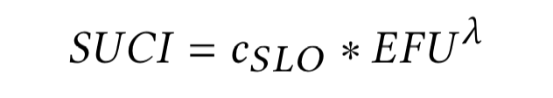
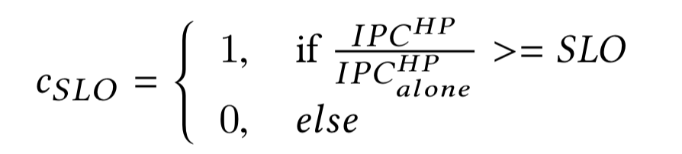
EVALUATION
SLO – EFU Combined Index
DICER optimizes both performance and system utilization
SUCI: SLO-Effective Utilization Combined Index
  A combined metric to quantify how well DICER performs in both targets
  where
  λ = 1 gives equal weights to conformance to SLO and effective utilization
  λ < 1 favors effective utilization
  λ > 1 favors conformance to SLOs

Slide 28
EVALUATION
SLO – EFU Combined Index
DICER outperforms
UM and CT
in all cases
DICER is effective in minimizing SLO violations
& in maximizing server utilization
λ = 1
equal weights
λ = 2
c_{SLO} favored
λ = 0.5
EFU favored

Slide 29
Conclusions
Simple co-location policies do not suffice to safeguard QoS
and increase system utilization
DICER achieves high performance for the HP application
and high effective system utilization
  Operates agnostically to the workload and the target performance of the HP
  Uses resource monitoring to adapt the LLC allocation to the current needs of the HP
  Assigns unnecessary cache space to the BEs
Other directions
Dynamic memory-bandwidth partitioning
Dynamic management of the number of co-located BΕs
Overlapping cache partitions
User-faced or provider-faced scenarios

Slide 30
Thank you! Questions?
nikela@cslab.ece.ntua.gr
This research has received funding from the European Union’s H2020 research and innovation programme under Grant Agreement no 732366 (ACTiCLOUD)

Slide 31
DICER - Parameters
BW saturation:
IPC stability:
Monitoring period | T = 1s
BW saturation threshold | MemBW_threshold = 50Gbps
Phase detection threshold | 30%
IPC stability percentage | a = 5%

Slide 32
DICER – Sampling period

Slide 33
DICER – Bandwidth saturation threshold
High-Priority
Best-Effort
Bandwidth saturation:
Total BW (t) > BW_LIMIT
We select 50 GB/sec (80%) as the bandwidth saturation limit

Slide 34
DICER – Phase change threshold
Phase change when:
No sensitivity
We select 30%

Slide 35
DICER – Monitor
monitor():
BW_saturated = False
measure_IPC_HP()
measure_MemBW_HP()
measure_MemBW()
if MemBW > MemBW_threshold:
BW_saturated = True
return
Measures the IPC of the HP,
the memory bandwidth of the HP
and the global bandwidth
Detects bandwidth saturation
The monitor assesses the performance of the workload at the end of every sampling period

Slide 36
DICER – Sampling
allocation_sampling():
CT_Favoured = False
(optimal_allocation, IPC_opt) = sampling()
current_allocation = optimal_allocation
return
Detects optimal allocation
and sets it
Sampling applies decreasing LLC partition sizes to the HP to find an optimal allocation

Slide 37
DICER – Main driver
current_allocation.HP = N−1
current_allocation.BE = 1
optimal_allocation = current_allocation
CT_Favored = True
dicer_driver():
while(1):
monitor()
if BW_saturated:
allocation_sampling()
else:
allocation_optimisation()
return
Initial allocation as in CT
Optimal allocation unknown
Workload considered CT-F
Continuous monitoring
Bandwidth saturated:
the workload is considered CT-T - sampling
Continuous allocation optimization

Slide 38
DICER – Cache allocation optimization
allocation_optimisation():
if phase_change():
allocation_reset()
return
if performance_stable():
current_allocation.HP -= 1
current_allocation.BE += 1
else:
if performance_better():
return
else:
allocation_reset()
return
Phase change:
bandwidth consumed by the HP increased - reset
Stable performance:
give 1 way to BEs
Better performance:
no allocation changes
Worse performance:
reset
The cache allocation optimization path is followed for CT-F workloads

Slide 39
DICER – Cache allocation reset (CT-F)
allocation_reset():
if CT_Favored:
rollback_allocation = current_allocation
current_allocation = optimal_allocation
monitor()
if BW_saturated:
allocation_sampling()
return
if performance_better():
return
else:
current_allocation = rollback_allocation
return
Reset allocation
to past optimal
Workload is now CT-T:
sampling
Better performance:
no allocation changes
Same performance:
reset was triggered by phase change - rollback
The cache allocation reset path is followed when there is a phase change or HP’s IPC has degraded

Slide 40
DICER – Cache allocation reset (CT-T)
…
else:
current_allocation = optimal_allocation
monitor()
if BW_saturated:
allocation_sampling()
return
if performance_near_opt():
return
else:
allocation_sampling()
return
Reset allocation
to last optimal
Bandwidth saturation detected again:
sampling
Performance near past optimal:
no allocation changes
Worse performance:
Optimal allocation has changed - sampling
The cache allocation reset path is followed when there is a phase change or HP’s IPC has degraded

