Slide 1
DaxVM: Stressing the Limits of Memory as a File Interface
Chloe Alverti, Vasileios karakostas*, NIKHITA KUNATI⁺,
Georgios Goumas, MICHAEL SWIFT**
Notes:
Increase Fonts
Add logos

Slide 2
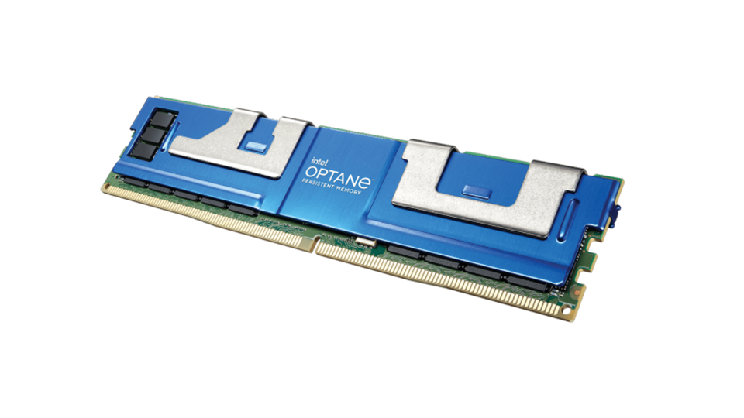
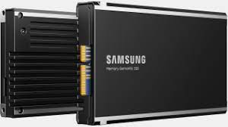
New Era: Direct Access to Fast Byte-Addressable Storage
Persistent Memory
Memory Bus
Intel’s Optane
Kioxia and Everspin SCM products
Hardware
Flash SSDs
Compute Express Link
Samsung’s CXL Memory
Semantic SSD
Direct Access (DAX) → bypass files data DRAM buffering (page cache)
SW Interface
DAX read/write system calls
DAX mmap
Notes:
Minimize it to two examples – not hierarchy – fast just mention that there is an aletrnative

Slide 3
Direct Access: The different interfaces
Application
User-Space
Virtual Address
(Buffer)
DAX-read()
Kernel-Space
Copy x bytes
File
DRAM
PMEM

Slide 4
Direct Access: The different interfaces
Application
User-Space
Virtual Address
(Buffer)
DAX-mmap()
Load/Store
Kernel-Space
Mapping set
File
DRAM
PMEM
Dax-MM provides true zero-copy and kernel-bypass storage access

Slide 5
Direct Access: Interfaces performance
Latency to access file once
Repetitive 4KB access
Higher is better
Up to 50%
Lower is better
MM avoids 25M syscalls
Huge Pages
sensitive to fs fragmentation (running on an aged ext4)
Small Files Problem
The Problem: DAX-MM performs poorly, commonly much worse than read
Notes:
Add some numbers – here (remove animation from slide for timing)

Slide 6
Dax-MM performs poorly
But Why?

Slide 7
Memory as a file interface
Overhead Source
Virtual Address Space
DRAM
PMem
File pages

Slide 8
Memory as a file interface
Overhead Source
1. Page Faults (page table setup)
DAX-mmap()
Virtual Address Space
VMA
DRAM
PMem
PTE
PMD
PUD
PGD
File pages
Page Faults and page table setup is expensive

Slide 9
Memory as a file interface
DAX-munmap()
Overhead Source
1. Page Faults (page table setup)
2. Synchronous release – TLB shootdowns
Virtual Address Space
TLB shootdowns
TLB
TLB
TLB
TLB
RO
RO
VMA
DRAM
PMem
PMD
PUD
PGD
File pages
TLB shootdowns are inherently non-scalable → IPIs
TLB shootdowns are expensive (x1000 of cycles)

Slide 10
Motivation: Virtual Memory is the Bottleneck
Virtual Memory Overheads
DaxVM
Source of Overhead
1. Page Faults + Page Table Setup
2. Synchronous Resource Release
O(1) mmap through file tables
Asynchronous release in batches
3. Address Space allocator (VM locks)
4. Kernel Dirty Page tracking
5. Block zeroing
Ephemeral mappings
clwb
+ MAP_NO_MSYNC
Asynchronous pre
-
zeroing
Notes:
Just jump from problem to solution.

Slide 11
Motivation: Virtual Memory is the Bottleneck
Virtual Memory
Virtual Memory Overheads
DaxVM
Source of Overhead
1. Page Faults + Page Table Setup
2. Synchronous Resource Release
O(1) mmap through file tables
Asynchronous release in batches
3. Address Space allocator (VM locks)
4. Kernel Dirty Page tracking
5. Block zeroing
Ephemeral mappings
clwb
+ MAP_NO_MSYNC
Asynchronous pre
-
zeroing
Notes:
Just jump from problem to solution.

Slide 12
DaxVM: O(1) MMap via pre-populated file tables
Observation: Files are in a byte-addressable medium. DAX mappings physical translations are known; they are storage locations.
Virtual Address Space
File system → persistent page table fragments per file
VMA
Process 1
File 1 Data Pages
mm_struct
PMD
PTE
PUD
1
2
3
4
5
O(1) mmap → attach fragments to process volatile page table trees
PGD
RO
Inode1
PMD
Offset
Shared among processes
What about permissions?
What about metadata (dirty bit)?
More in the paper
Process 2
PTE
mm_struct
0xa
PMD
0x3
PUD
0xc
0xf
RW
DaxVM shared
File System
PGD
mapping
DRAM
PMEM
Related Work: O(1) Memory [HotOS’17] and FlashMap [ISCA ‘15]

Slide 13
DaxVM: Asynchronous Resource Release
Observation: Dax mappings do not consume volatile resources.
TLB
TLB
TLB
TLB
Munmap → not synchronous
Batch requests → similar to IOMMU optimizations
Threshold reached
TLB total flush
VMA
Avoid frequent shootdowns, pay one cheaper total flush
VMA
VMA
VMA1
VMA2
VMA3
VMA
VMA
VMA
Thread 1
Thread 2
Thread 3
VMA
VMA
VMA
VMA
buf = mmap(file);
process(buf);
munmap(buf);
zombie
Virtual Address Space

Slide 14
Platform
DaxVM implemented in Linux and ext4/NOVA
Intel Optane 384GB (3 DCPM DIMMs in AppDirect)
Comparison
Experimental
Setup
Linux read/write system calls
Linux Mmap
Workloads
Microbenchmarks
Webserver (many small files, e.g. Apache)
Redis boot time
RocksDB-PMem and YCSB operational throughput
…more in the paper

Slide 15
Micro-benchmarks
Latency to access file once
Repetitive 4KB access
Lower is better
Higher is better

Slide 16
Apache

Slide 17
Thank You ☺
Problem: The OS memory-mapping (MM) interface performs poorly, limiting direct user-space access to byte-addressable storage (e.g. PMEM)
DaxVM*: a new POSIX-relaxed ΜΜ interface (Linux + ext4/NOVA)
O(1) memory mapping (mmap)
Asynchronous resource release (munmap)
…more in the paper
*https://github.com/cslab-ntua/DaxVM-micro2022
Notes:
come close to the limit of what hardware can provide

Slide 18
Thank You ☺
DaxVM: a new POSIX-relaxed ΜΜ interface implemented in Linux that comes close to what hardware can provide in terms of DAX performance
*https://github.com/cslab-ntua/DaxVM-micro2022

Slide 19
Backup slides

Slide 20
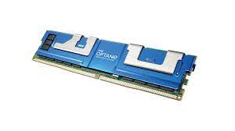
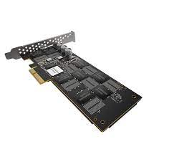
New Era: Fast Storage and Direct Access
Direct access to byte-addressable storage (DAX)
DRAM
Flash SSD
HDD
PMEM
(sub)-usec NVMe
Flash NVMe
Optane
Memory bus
CXL Memory
Semantic SSD
Z-SSD Samsung
Compute Express Link is coming
Fast storage and DAX bridge the gap between memory and storage
Notes:
Minimize it to two examples – not hierarchy – fast just mention that there is an aletrnative

Slide 21
Memory as a file interface
DAX-mmap()
Virtual Address Space
Overhead Source
1. Page Faults (page table setup)
2. Lock contention (VM mm sem)
VMA
down_write (mm→mmap_sem)
mm→mmap_sem
VMA
VMA
VMA
VMA
VMA
VMA
VMA
VMA
VMA
VMA
VMA

Slide 22
Memory as a file interface
DAX-munmap()
Virtual Address Space
Overhead Source
1. Page Faults (page table setup)
2. Lock contention (VM mm sem)
VMA
down_write (mm→mmap_sem)
mm→mmap_sem
VMA
VMA
VMA
VMA
VMA
VMA
VMA
VMA
VMA
VMA
VMA

Slide 23
Memory as a file interface
DAX-m(un)map()
Virtual Address Space
Overhead Source
1. Page Faults (page table setup)
2. Lock contention (VM mm sem)
VMA1
VMA2
VMA3
Thread 1
Thread 2
Thread 3
down_write (mm→mmap_sem)
mm→mmap_sem
VMA
VMA
VMA
VMA
VMA
VMA
VMA
VMA
VMA
VMA
VMA
VM locks serialize address space operations
VMA
VMA

Slide 24
Memory as a file interface
DAX-m(un)map()
Virtual Address Space
Overhead Source
1. Page Faults (page table setup)
2. Lock contention (VM mm sem)
VMA1
VMA2
VMA3
Thread 1
Thread 2
Thread 3
down_write (mm→mmap_sem)
mm→mmap_sem
VMA
VMA
VMA
VMA
VMA
VMA
VMA
VMA
VMA
VMA
VMA
VM locks serialize address space operations
VMA
VMA

Slide 25
DaxVM: O(1) MMap via pre-populated file tables
Virtual Address Space
File system maintains persistent pre-populated page tables per file
VMA
Process 1
File 1 Data Pages
O(1) MMap → attach fragments to process volatile page tables at almost constant time
mm_struct
PMD
PTE
PUD
1
2
3
4
5
PGD
RO
Inode1
PMD
Offset
Shared among processes
What about permissions?
Process 2
PTE
PTE
mm_struct
1
5
PMD
2
PUD
3
4
RW
DaxVM shared
File System
More in the paper (e.g. dirty bit)
PGD
mapping
DRAM
PMEM
Related Work: O(1) Memory [HotOS’17] and FlashMap [ISCA ‘15]

Slide 26
Memory as a file interface
DAX-m(un)map()
Virtual Address Space
Overhead Source
1. Page Faults (page table setup)
2. Synchronous release – TLB shootdowns
VMA1
VMA2
VMA3
Thread 1
Thread 2
Thread 3
Many threads over multiple files
Thread Function:
buf = mmap(file);
process_data(buf);
munmap(file);
TLB shootdowns are inherently non-scalable → IPIs

Slide 27
Direct Access: Interfaces performance
Latency to access file once
Latency and throughput to access file once
Repetitive 4KB access
Up to 50%
MM avoids 25M syscalls
MM access performs worse than read, especially for small files, despite true zero-copy
MM access does not scale to many cores
MM access performs worse than read, despite kernel bypass
Huge Pages
sensitive to fs fragmentation (running on an aged ext4)
Small Files Problem
Notes:
Add some numbers – here (remove animation from slide for timing)

Slide 28
Executive Summary
Problem: The poor performance of MMap limits the direct user-space access to byte-addressable storage (e.g. PMEM)
DaxVM*: a new POSIX-relaxed ΜΜ interface
O(1) mmap
Asynchronous resource release
Scalable virtual address (de)allocator for ephemeral mappings
No kernel-space dirty-page tracking (optionally)
Asynchronous block pre-zeroing
Results (an example):
4.9x speedup over the default MM and 1.5x over the read syscall for Apache
Fast boot times and operational throughput for key-value stores (in paper)
*https://github.com/cslab-ntua/DaxVM-micro2022

Slide 29
Executive Summary
Problem: The OS memory-mapping (MM) interface performs poorly, limiting direct user-space access to byte-addressable storage (e.g. PMEM)
DaxVM*: a new POSIX-relaxed ΜΜ interface
O(1) memory mapping (mmap)
Asynchronous resource release (munmap)
…more in the paper
Results (an example):
Apache: 4.9x throughput vs default MM and 1.5x vs the read syscall interface
*https://github.com/cslab-ntua/DaxVM-micro2022
Notes:
come close to the limit of what hardware can provide

Slide 30
Executive Summary
Problem: The OS memory-mapping (MM) interface performs poorly, limiting direct user-space access to byte-addressable storage (e.g. PMEM)
*https://github.com/cslab-ntua/DaxVM-micro2022
Notes:
come close to the limit of what hardware can provide

Slide 31
New Era: Direct Access to Fast Byte-Addressable Storage
Persistent Memory
Memory Bus
Intel’s Optane
Kioxia and Everspin SCM products
Flash SSDs
Compute Express Link
Samsung’s CXL Memory
Semantic SSD
But what about the available interfaces?
Notes:
Minimize it to two examples – not hierarchy – fast just mention that there is an aletrnative

Slide 32
Direct Access: The different interfaces
Direct Access (DAX) → bypass files data DRAM buffering (page cache)
DAX read/write system calls
DAX mmap

Slide 33
DaxVM: O(1) MMap via pre-populated file tables
Observation: Files are in a byte-addressable medium. DAX mappings physical translations are known; they are storage locations.
Virtual Address Space
File system → persistent page table fragments per file
VMA
Process 1
File 1 Data Pages
mm_struct
PMD
PTE
PUD
1
2
3
4
5
O(1) mmap → attach fragments to process volatile page table trees
PGD
RO
Inode1
PMD
Offset
Shared among processes
What about permissions?
What about metadata (dirty bit)?
More in the paper
Process 2
PTE
PTE
mm_struct
0xa
0x9
PMD
0x3
PUD
0xc
0xf
RW
DaxVM shared
File System
PGD
mapping
DRAM
PMEM
Related Work: O(1) Memory [HotOS’17] and FlashMap [ISCA ‘15]

